Slide 1
DBMS –
ENTITY -RELATIONSHIP MODEL

Slide 2
Entity-Relationship Model
Design Process
Modeling
Constraints
E-R Diagram

Slide 3
Modeling
A database can be modeled as:
  a collection of entities,
  relationship among entities.
An entity is an object that exists and is distinguishable from other objects.
  Example: specific person, company, event, plant
Entities have attributes
  Example: people have names and addresses
An entity set is a set of entities of the same type that share the same properties.
  Example: set of all persons, companies, trees, holidays

Slide 4
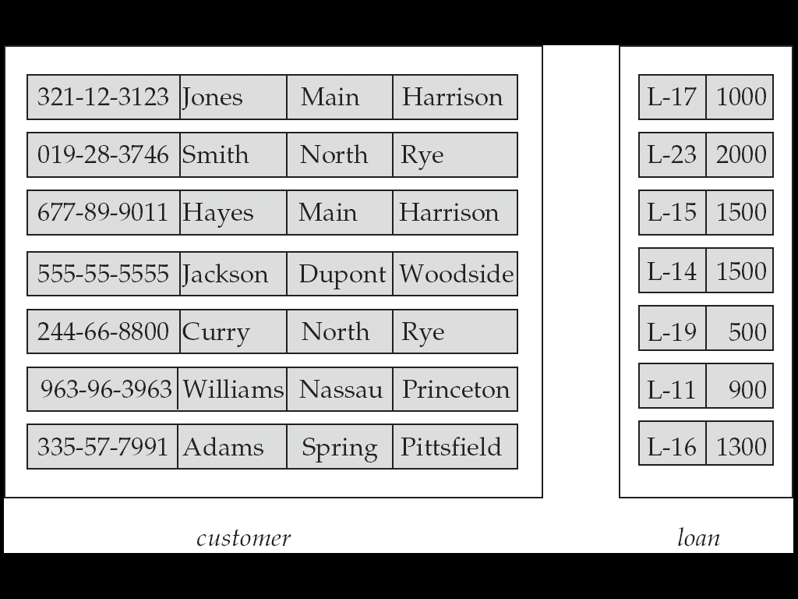
Entity Sets customer and loan
customer_id customer customer customer loan_ amount
name street city number

Slide 5
Relationship Sets
A relationship is an association among several entities
Example:
Hayes depositor A-102
customer entity relationship set account entity
A relationship set is a mathematical relation among n ≥ 2 entities, each taken from entity sets
{(e₁, e₂, … e_{n}) | e₁ ∈ E₁, e₂ ∈ E₂, …, e_{n} ∈ E_{n}}
where (e₁, e₂, …, e_{n}) is a relationship
  Example: (Hayes, A-102) ∈ depositor

Slide 6
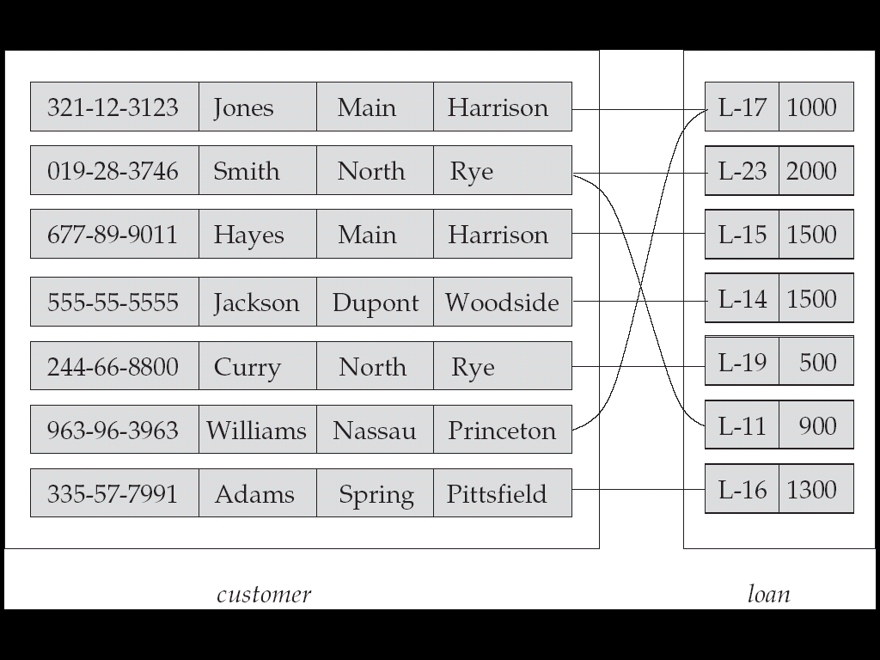
Relationship Set borrower

Slide 7
Degree of a Relationship Set
Refers to number of entity sets that participate in a relationship set.
Relationship sets that involve two entity sets are binary (or degree two). Generally, most relationship sets in a database system are binary.
Relationship sets may involve more than two entity sets.
  Example: Suppose employees of a bank may have jobs (responsibilities) at multiple branches, with different jobs at different branches. Then there is a ternary relationship set between entity sets employee, job, and branch

Slide 8
Attributes
An entity is represented by a set of attributes, that is descriptive properties possessed by all members of an entity set.
Example:
  Student (Regno, Name, DoB, Address, Phone)
  Employee (EmpID, Name, DoJ, Qualification)
Domain – the set of permitted values for each attribute
Example:
  Student (101, Ram, 12.06.2000, AbC Street, 123456789)
  Employee (1257, Latha, 03.11.1999, PhD)
Attribute types:
  Single-valued and multi-valued attributes
    Example: multivalued attribute: phone_numbers
    Example: Single value attribute: Age, DoB
  Derived attributes
    Can be computed from other attributes
    Example: Age, given date_of_birth
  Composite attributes
    Combination of tow or more attributes
    Example: Name (First, Middle, Last), Address (Doorno, Street Name, Area name, City, Pin)

Slide 9
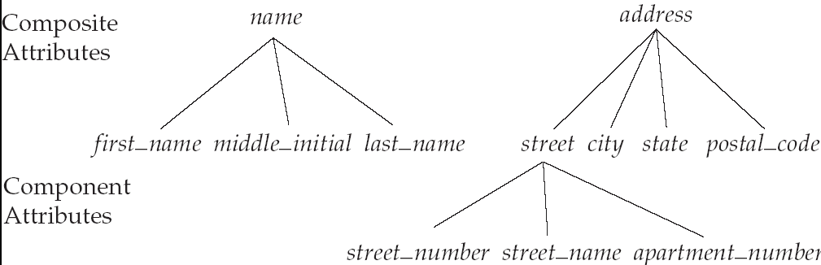
Composite Attributes

Slide 10
Terminologies – a visit
Entity
Entity Set
Relationship
Relationship set
Attributes
  Single valued
  Multi valued
  Composite
  Derived

Slide 11
Mapping Cardinality Constraints
Express the number of entities to which another entity can be associated via a relationship set.
Most useful in describing binary relationship sets.
For a binary relationship set the mapping cardinality must be one of the following types:
  One to one
  One to many
  Many to one
  Many to many

Slide 12
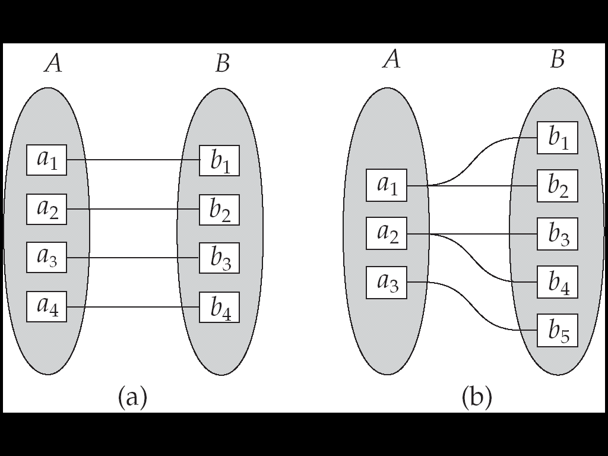
Mapping Cardinalities
One to one
One to many
Note: Some elements in A and B may not be mapped to any
elements in the other set
Example: Set A – Department details Set B – Location
Mapping A to B is one to one (CSE – AB3)
Mapping B to A is many to one (AB3 has many departments)

Slide 13
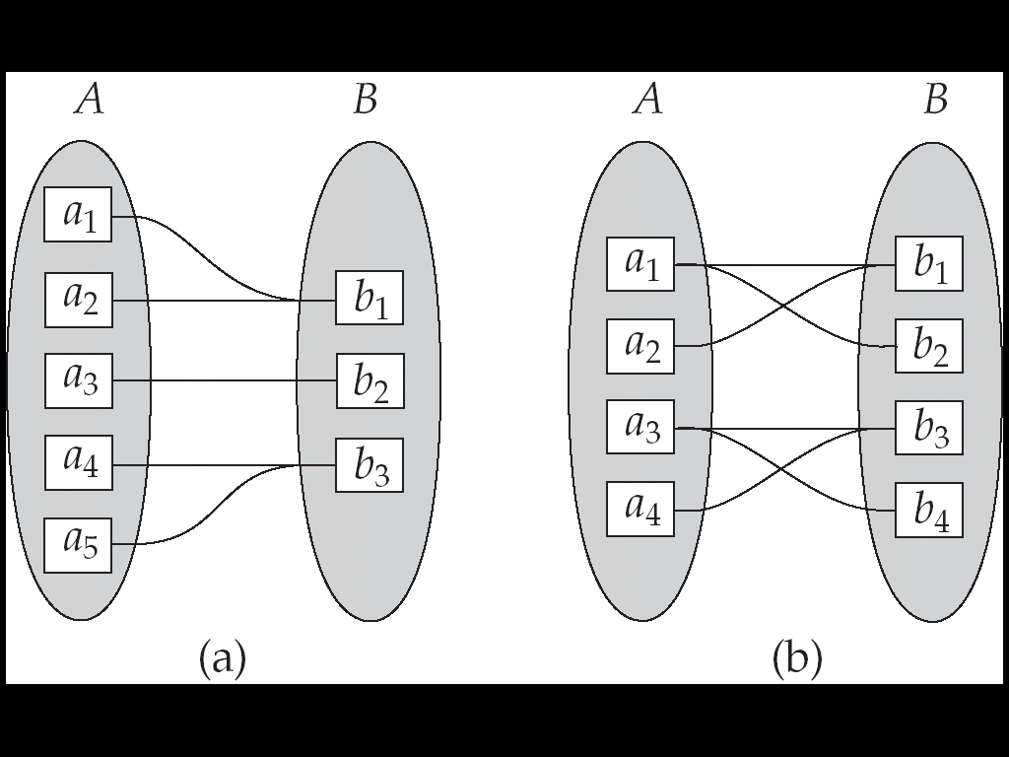
Mapping Cardinalities
Many to one
Many to many
Note: Some elements in A and B may not be mapped to any
elements in the other set
Set A –Students, Set B – Department
Many students belong to one Department – Many to one
Set A – Courses Set B – Students
Many Courses are taken by many students – Many to many

Slide 14
Keys
Primary Key: Set of attributes that uniquely identifies a tuple in a entity – Should not allow duplicate values in that attribute
Identify Primary keys in the following:
  Student (RegNo, Name, Address, DoB)
  Employee (EmpID, Name, Address, DoB, DoJ)
  Department (DeptID, Name, Location)
  Items (ProductID, Name, stock, price)
  Account(AccNo, Name, Balance)
Why Primary Key? -- To uniquely identify a particular tuple.
  If no primary keys – Data integrity is lost – all students have same regno. – See the confusion.
Aadhar No – Primary key to uniquely identify a citizen in India.

Slide 15
Composite Primary Key
One or more attribute is a primary key
Example: One order has multiple products
  Order(OrderNo, ProductCode, Quantity, price) – Only with OrderNo and ProductCode we can identity single tuple
    Only OrderNo will give multiple tuples
    Only ProductCode will give multiple tuples
  Exam(RegNo, CourseCode, Grade) – Only with Regno and CourseCode we can get single tuple.
    Only RegNo will give grade of all courses
    Only CourseCode will give results of all students

Slide 16
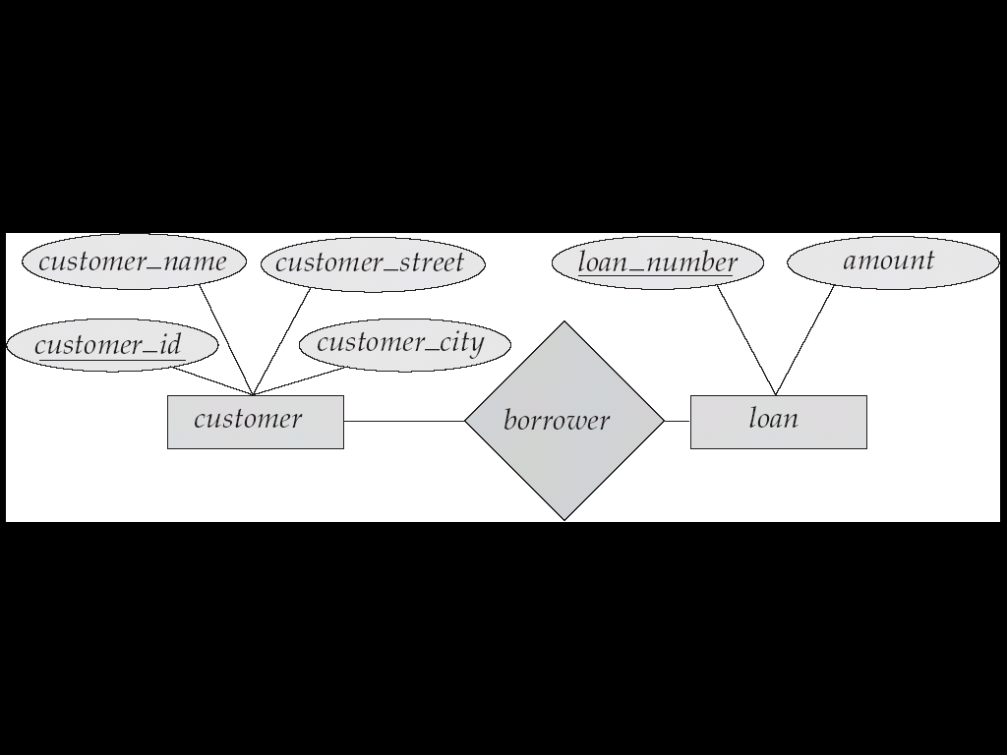
Entity –Relationship Diagrams (ERD)
Rectangles represent entity sets.
Diamonds represent relationship sets.
Lines link attributes to entity sets and entity sets to relationship sets.
Ellipses represent attributes
  Double ellipses represent multivalued attributes.
  Dashed ellipses denote derived attributes.
Underline indicates primary key attributes

Slide 17
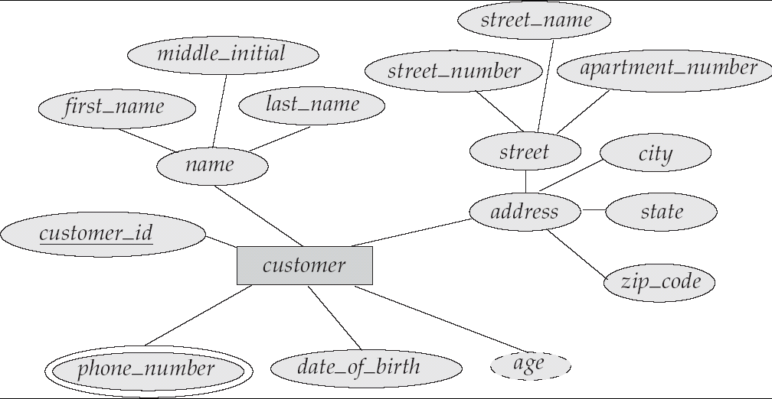
E-R Diagram With Composite, Multivalued, and Derived Attributes

Slide 18
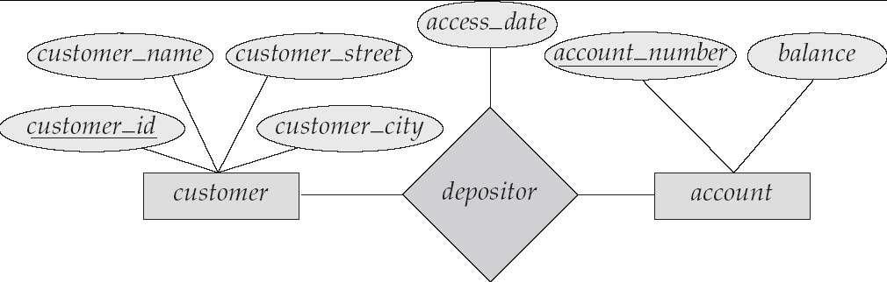
Relationship Sets with Attributes

Slide 19
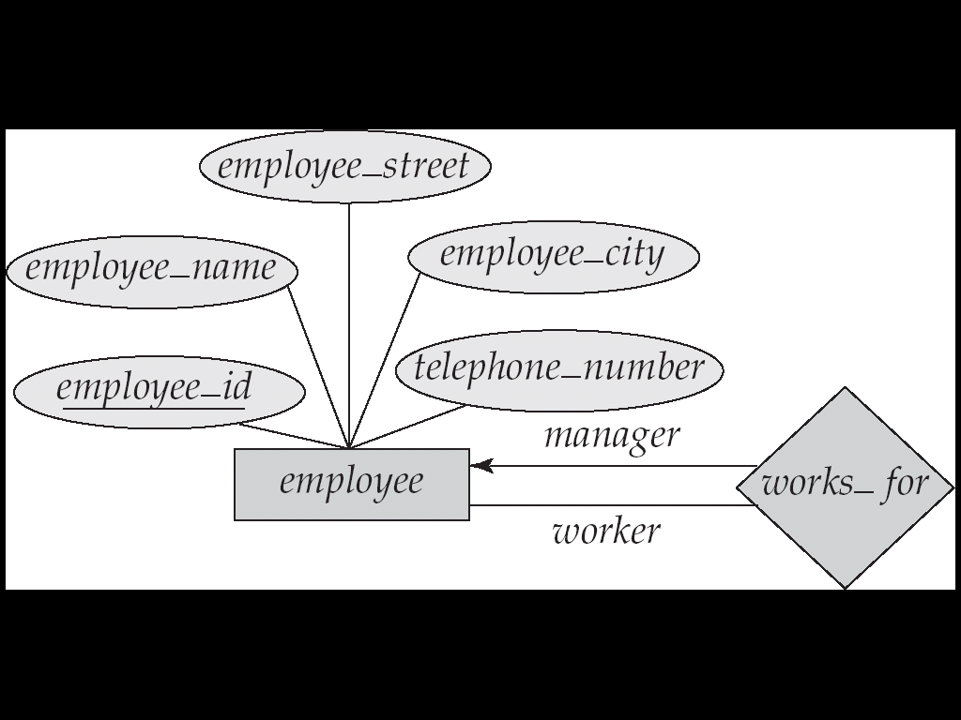
Roles
Entity sets of a relationship need not be distinct
The labels “manager” and “worker” are called roles; they specify how employee entities interact via the works_for relationship set.
Roles are indicated in E-R diagrams by labeling the lines that connect diamonds to rectangles.
Role labels are optional, and are used to clarify semantics of the relationship

Slide 20
Cardinality Constraints
We express cardinality constraints by drawing either a directed line (→), signifying “one,” or an undirected line (—), signifying “many,” between the relationship set and the entity set.
One-to-one relationship:
  A customer is associated with at most one loan via the relationship borrower
  A loan is associated with at most one customer via borrower

Slide 21

One-To-Many Relationship
In the one-to-many relationship a loan is associated with at most one customer via borrower, a customer is associated with several (including 0) loans via borrower

Slide 22
Many-To-One Relationships
In a many-to-one relationship a loan is associated with several (including 0) customers via borrower, a customer is associated with at most one loan via borrower

Slide 23

Many-To-Many Relationship
A customer is associated with several (possibly 0) loans via borrower
A loan is associated with several (possibly 0) customers via borrower

Slide 24
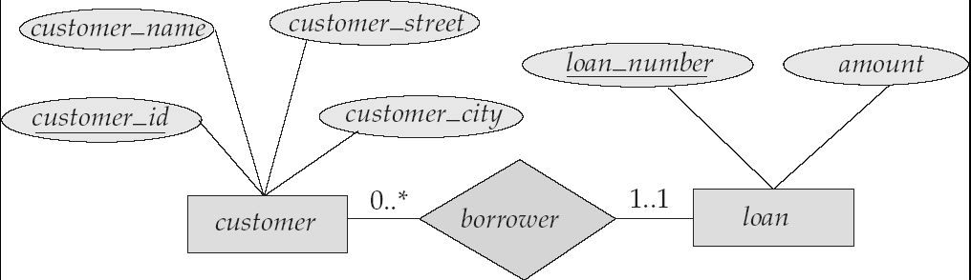
Alternative Notation for Cardinality Limits
Cardinality limits can also express participation constraints

Slide 25
Case Study
For the following Entities, Identify Primark Key, Identify relationship, cardinality and Draw ER Diagram
Case 1:
  Department (DeptId, Name, YearOfStart, Location)
  Student (Regno, Name, DoB, Address, Branch, Batch)
  Courses(DeptId, CourseCode, Title, EvalPattern)
Case 2:
  City(CityId, CityName, Remarks)
  Product(ProdCode, ProdName, Stock, Price, CityId)
  Customer(CustomerId, CustName, Address, OrderId)
  Orders(OrderId, ProdCode, Quantity)
  Bills(OrderId, Cost, Tax, ShipCharges, Total, Remarks)

Slide 26
Reference Key or Foreign Key
A Foreign key (or reference key) is a key borrowed from another related table (that’s why its foreign) in order to make the relationship between two entities
A key to connect two entities – Allows duplicate values
Parent Entity – An entity that does not depend for its existence on other entities – Has a Primary Key (may or may not have foreign keys)
Child Entity (referential entity) – An entity that depends for its existence on other entities – Should have a reference (foreign) key

Slide 27
Identify all keys in the following, Draw ER Diagram
Case 1:
  Department (DeptId, Name, YearOfStart, Location) - No Foreign Key
  Student (Regno, Name, DoB, Address, Branch, Batch)
  Courses(DeptId, CourseCode, Title, EvalPattern)
  Grades(Regno, CourseCode, Grade)
Case 2: -- Do this now.
  City(CityId, CityName, Remarks)
  Product(ProdCode, ProdName, Stock, Price, CityId)
  Customer(CustomerId, CustName, Address, OrderId)
  Orders(OrderId, ProdCode, Quantity)
  Bills(OrderId, Cost, Tax, ShipCharges, Total, Remarks)

